Slide 1
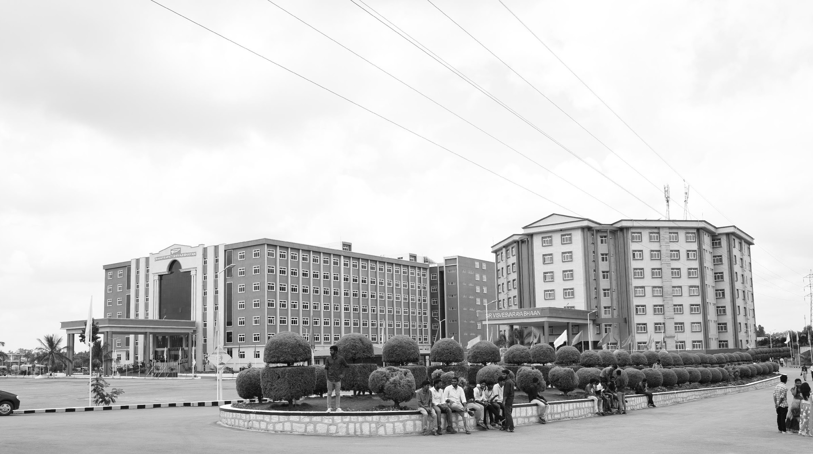

INTEGRATED RENEWABLE ENERGY SYSTEM
Mid-Review 1/2/3
Major Project
Project ID: A23
AY 2021-25
GITAM (Deemed-to-be) University
Project Team:
A.MAHESH (0339)
V.SAI KIRAN(0449)
Department of Electrical Electronics and Communication Engineering
Project Mentor:
DR.JAYATHEERTHAJ
Project In-charge:
DR.ARUN KUMAR
www.gitam.edu

Slide 2
AGENDA
● OBJECTIVE AND GOALS
● GHANT CHART
● ABSTRACT
● LITERATURE SURVEY
● ARCHITECTURE
● WORKING PRINCIPLE METHOD
● SIMULATION
● CONCLUSION

Slide 3
Simulation of Integrated Renewable Energy Systems
• Purpose: Model interactions between solar, wind, storage, and grid components.
• Key Metrics: Energy output, reliability, cost-efficiency, and emissions reduction.
• Tools: Use software like HOMER, MATLAB, or PLEXOS for system modeling and optimization
• Outcome: Data-driven insights for system design and performance improvement.

Slide 4
Objective and Goals
Objective
The primary objective of an Integrated Renewable Energy System is to efficiently combine multiple renewable energy sources — such as solar, wind, biomass, hydro, and geothermal — to ensure continuous, reliable, and sustainable energy supply. It aims to:
Goals
Efficient Resource Integration: To combine various renewable energy sources such as solar, wind, biomass, hydro, and geothermal into a unified system for maximum efficiency and reliability.
Continuous and Stable Power Supply: To ensure uninterrupted energy availability by balancing the variability of different renewable sources with smart controls and energy storage systems.
Energy Cost Optimization: To reduce energy production costs by utilizing abundant, free, and locally available renewable resources and reducing transmission losses.
Environmental Sustainability: To significantly lower greenhouse gas emissions and contribute to combating climate change through clean and eco-friendly energy production

Slide 5
ABSTRACT
The growing demand for clean, reliable, and sustainable energy has led to the development of Integrated Renewable Energy Systems (IRES). An IRES combines multiple renewable energy sources such as solar, wind, biomass, hydro, and geothermal power to create a stable, efficient, and environmentally friendly energy solution. By integrating different energy resources with energy storage and smart control technologies, these systems overcome the intermittent nature of individual renewable sources and ensure continuous power supply. The main objective of IRES is to maximize resource utilization, reduce dependence on fossil fuels, minimize environmental impact, and support energy access in remote and rural areas. IRES also contributes to energy security, economic development, and climate change mitigation. This paper/study explores the design, goals, benefits, and challenges of integrated renewable energy systems, highlighting their potential role in building a sustainable and resilient energy future

Slide 6
Literature Survey (Improved post minor project)
A comprehensive review of previous research highlights that while individual renewable energy sources have been widely adopted, their intermittency poses challenges. Studies show that hybrid systems combining solar, wind, and bioenergy improve reliability and power availability. Research also emphasizes the importance of energy storage and smart grid management for seamless integration. Successful case studies from rural electrification projects, urban microgrids, and industrial setups demonstrate the feasibility and benefits of integrated systems. Furthermore, literature reveals that policy support, financial incentives, and technological innovation are critical enablers for wider adoption.In addition, the literature review explores various modeling approaches used to simulate integrated renewable energy systems, such as optimization models, multi-objective analysis, and scenario-based simulations. Researchers have noted the effectiveness of energy storage technologies, including lithium-ion batteries, pumped hydro storage, and emerging solutions like compressed air energy storage, in stabilizing power outputs. Comparative studies between stand-alone renewable systems and integrated systems indicate that hybrid models offer cost advantages and higher capacity factors.

Slide 7
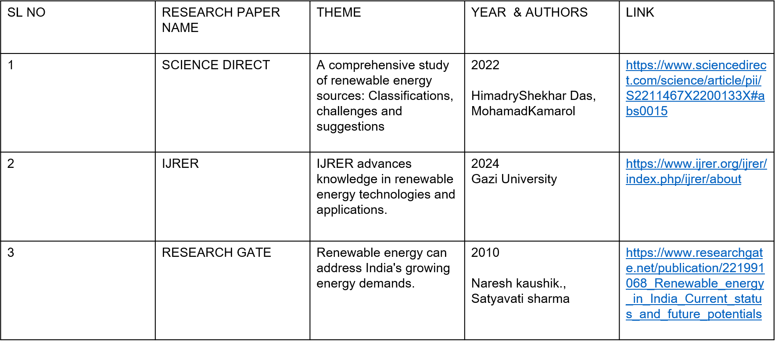
Literature Survey
LITERATURE SURVEY:

Slide 8
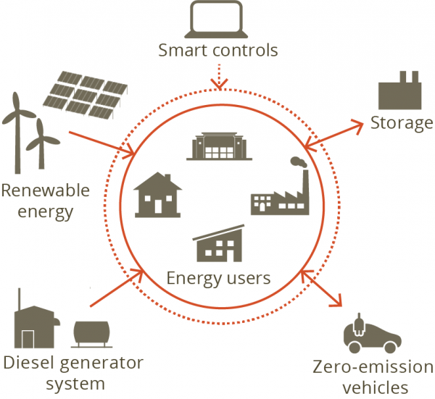
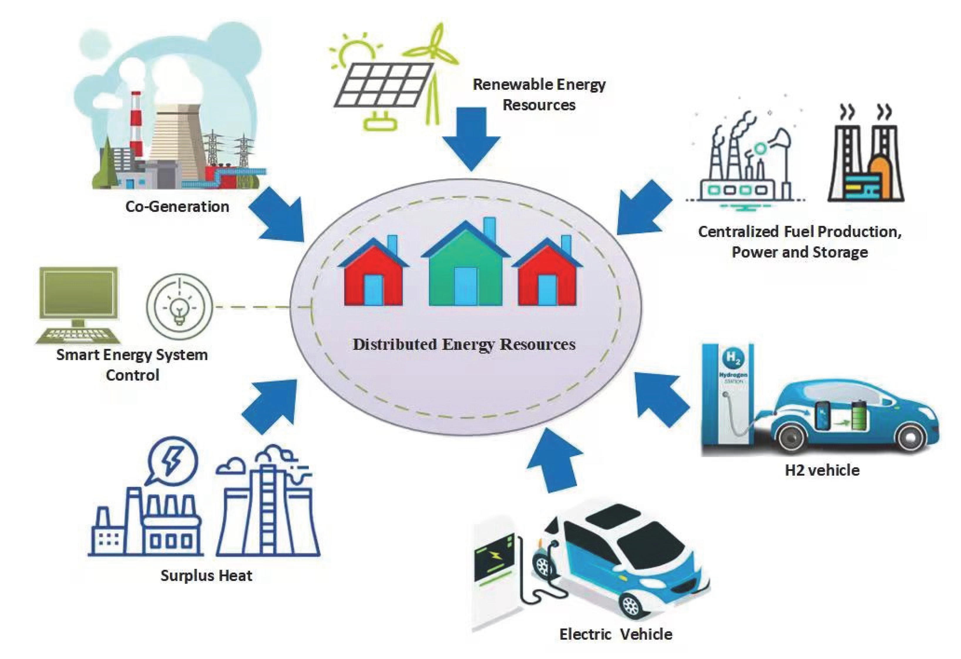
Architecture

Slide 9
WORKING PRINCIPLE OF HARDWARE
1. Solar Power Generation Unit:
Working Principle: Solar photovoltaic (PV) panels convert sunlight into DC electricity.
Hardware Involved:
Solar PV panels
Charge controllers (to prevent battery overcharging)
2. Wind Power Generation Unit:
Working Principle: Wind turbines convert the kinetic energy of wind into mechanical energy, which is then converted into electrical energy using generators.
Hardware Involved:
Wind turbine blades and nacelle
3. Biomass Power Unit:
Working Principle: Biomass is burned or digested to produce biogas, which powers an engine or generator to produce electricity.
Hardware Involved:
Biomass digester or furnace
Gas engine/generator
4. Micro-Hydro Power Unit (if included):
Working Principle: The potential energy of falling water is converted into mechanical energy by a turbine and then into electrical energy using a generator.
Hardware Involved:
Water turbine
Generator

Slide 10
sofware Implementation
1. System Simulation and Modeling:
Before physical implementation, the system is modeled using simulation tools such as:
MATLAB/Simulink for power flow simulation and performance analysis.
HOMER Pro for system design optimization, feasibility analysis, and cost modeling.
2. Control Algorithm Development:
Control logic is written and tested for:
Energy source prioritization (solar, wind, biomass, storage).
Battery charge/discharge management.
Load management based on availability of power..
3. Data Acquisition and Monitoring System:
Development of software for real-time data acquisition from sensors (voltage, current, temperature, and wind speed sensors).
Use of SCADA (Supervisory Control and Data Acquisition) systems or custom-built dashboards for centralized monitoring.
Data is displayed on LCD screens, HMIs, or web-based platforms.
4. Communication Protocols:
Implementation of communication protocols such as Modbus, CAN bus, or Wi-Fi/Bluetooth for reliable data transfer between hardware components and the monitoring system.
Remote monitoring and control features can be added using IoT-based platforms.

Slide 11
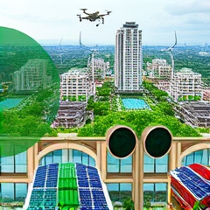
Future Trends in IRES
AI-Driven Energy Optimization: AI technologies can analyze energy usage patterns, improving efficiency and predictive maintenance in IRES.
Machine Learning Applications: Machine learning algorithms enhance real-time decision-making, optimizing energy distribution based on consumption forecasts.
Future of Automation: Automation in IRES operations enables seamless integration of energy sources and boosts overall system resilience.

Slide 12
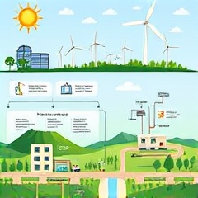
Steps for Implementing IRES in a Region
Planning Phase Importance: Efficient planning is crucial to assess local resources, regulatory frameworks, and community engagement for IRES.
Installation Best Practices: Adhering to technical standards and collaborating with local authorities ensures successful installation and operational efficiency.
Maintenance Strategies: Regular maintenance and monitoring protocols enhance IRES longevity, optimizing performance and minimizing unexpected downtime.

Slide 13
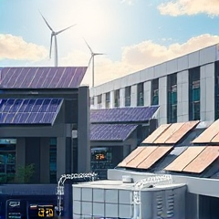
Energy Storage in IRES
Battery Technologies: Advanced lithium-ion and solid-state batteries provide efficient energy storage and quick discharge capabilities, enhancing IRES.
Hydrogen Storage: Hydrogen, produced via electrolysis, serves as a versatile energy carrier, enabling long-term storage and transport solutions.
Pumped Hydro Storage: Utilizing elevation changes, pumped hydro systems store energy efficiently by converting and releasing water in reservoirs.

Slide 14
Comparison with Conventional Energy Systems
Efficiency Comparison: IRES typically surpasses conventional systems in energy efficiency through optimized resource utilization and complementary sources.
Reliability Factors: Integrated systems enhance energy reliability by diversifying sources, reducing dependence on single energy types significantly.
Sustainability Advantages: IRES promotes sustainability by minimizing environmental impact, ensuring cleaner energy production compared to traditional methods.

Slide 15
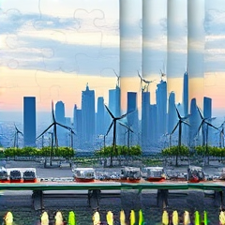
Challenges in Implementing IRES
Technical Challenges: Integration involves complex technologies requiring rigorous testing for compatibility and operational efficiency under various conditions.
Economic Constraints: High initial costs and uncertain returns discourage investments, necessitating innovative financing models to support adoption.
Policy Barriers: Regulatory inconsistencies and lack of supportive frameworks impede IRES deployment, highlighting the need for coordinated policy efforts.

Slide 16
Working Principle Method of Integrated renewable Energy Systems
Integration of multiple energy sources (solar, wind, hydro, storage) with a centralized or distributed grid
Energy flow managed through smart controllers that balance supply and demand in real-time.
Storage systems (batteries, pumped hydro) store excess energy for use during low-generation periods.
Predictive algorithms optimize load distribution and maximize system efficiency.

Slide 17
Conclusion
Integrated renewable energy systems are key to sustainable energy goals.
Combining solar, wind, storage, and smart grids improves reliability and reduces emissions.
These systems foster energy independence and resilience.
Innovation and strong policy support will drive the Innovation and strong policy support will drive the

Slide 18
THANK YOU
Have a Great Day !

